Slide 1
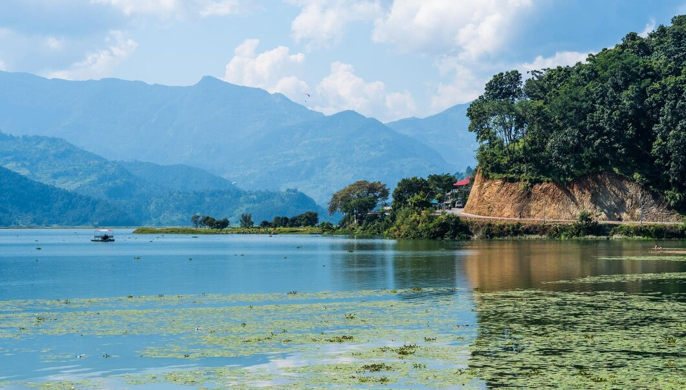
Phewa Lake

Slide 2



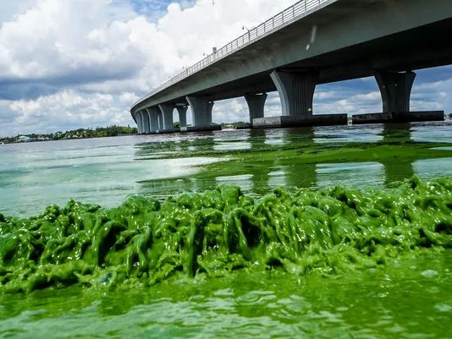

What is Algae?
Photosynthetic
Predominantly Aquatic
Nucleus bearing

Slide 3










PROBLEM 1
Eutrophication
Problem
PROBLEM 2
Hypoxia
PROBLEM 3
Skin Irritation

Slide 4


Algenol
PREPARED BY TEAM ANONYMOUS

Slide 5

PROBLEM 1
Mitigation
Algenol
PROBLEM 2
Prevention
PROBLEM 3
Elimination

Slide 6
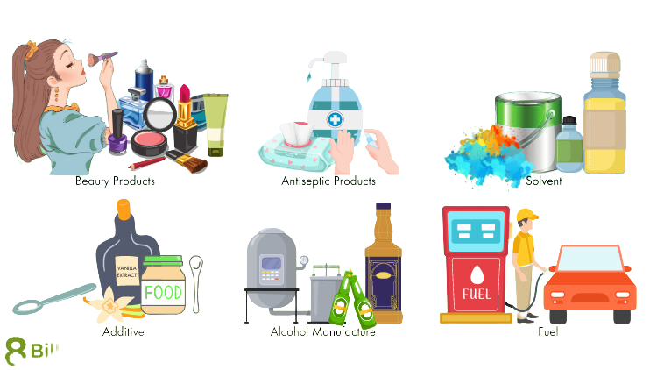





Beauty Product
Antiseptic
product
of service
Addictive
Alcohol
Ethanol
Solvent
Fuel

Slide 7



CULTIVATION
Carbohydrate extraction
Hydrolysis
Production
Fermentation
Distillation
Dehydration
Store and Use

Slide 8

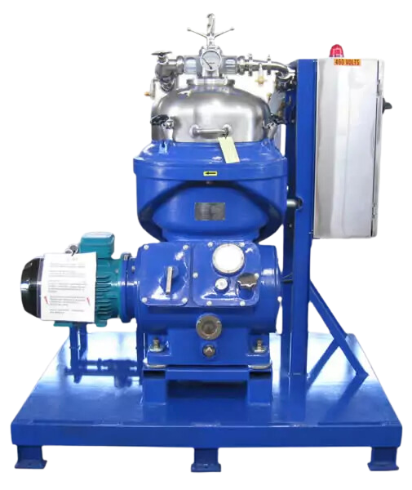
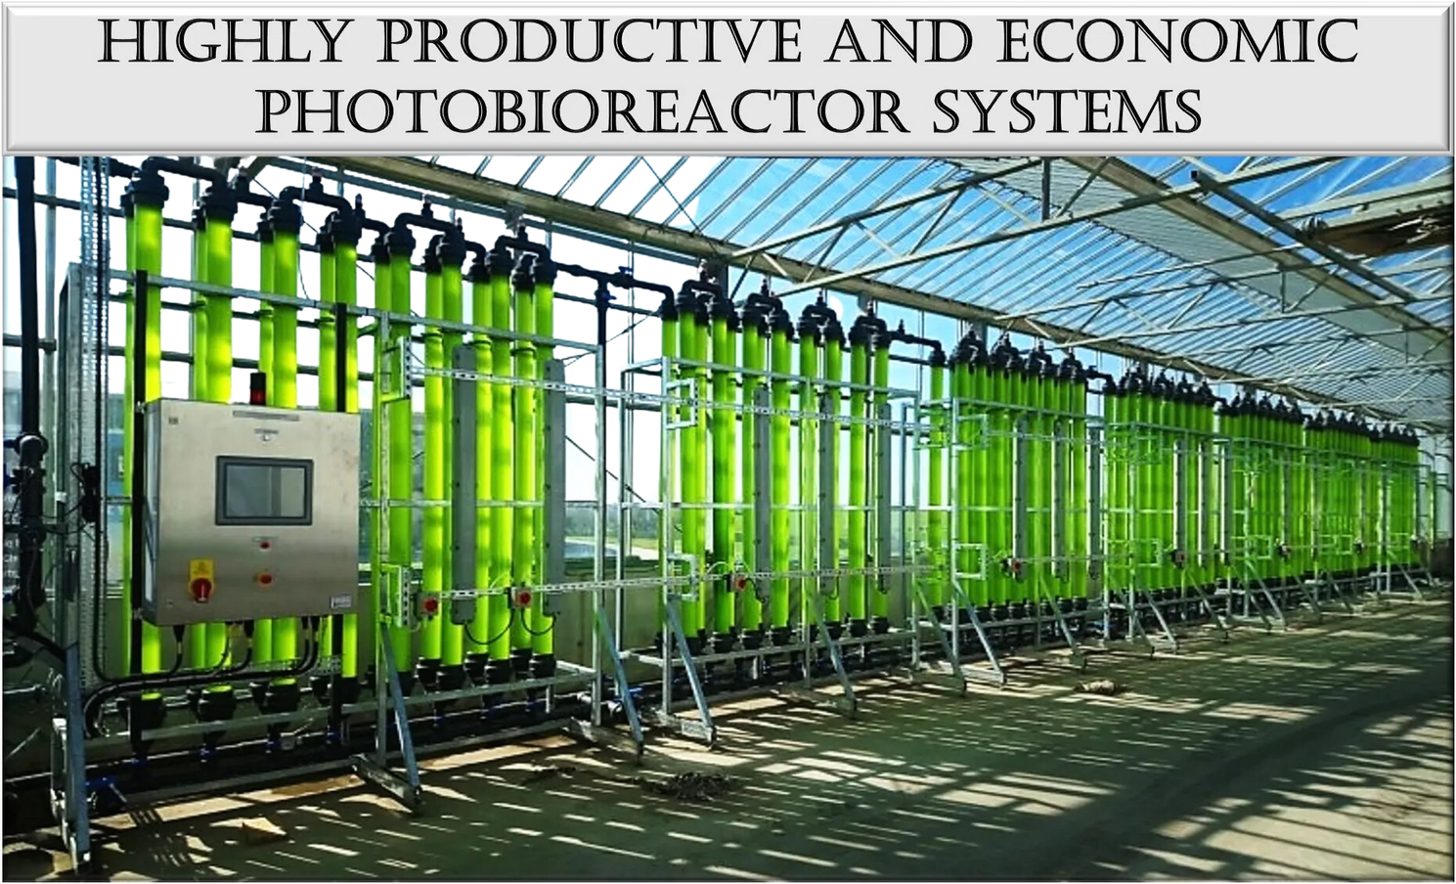
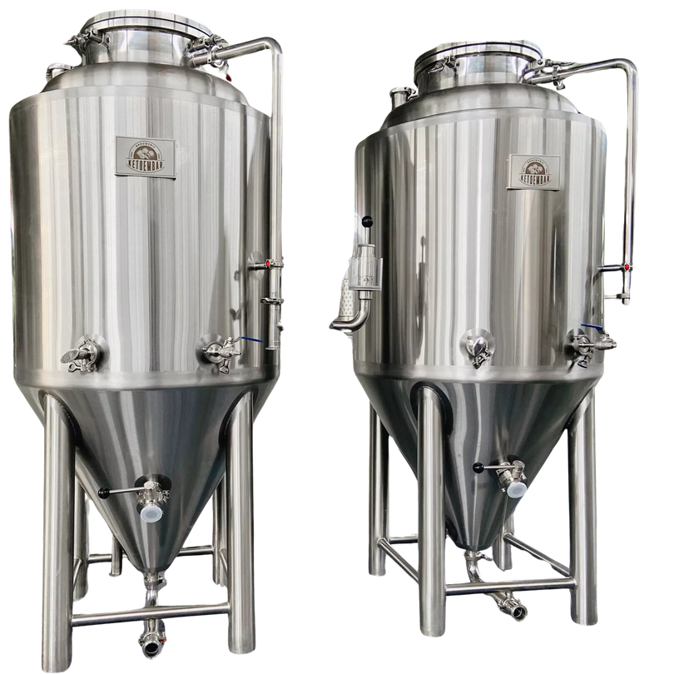
Machinery
Centrifuge
Fermentation Tank
photobioreactor
100L
US$3,000.00-3,500.00
$4,000.00-4,500.00
US$1,000-$10,000

Slide 9


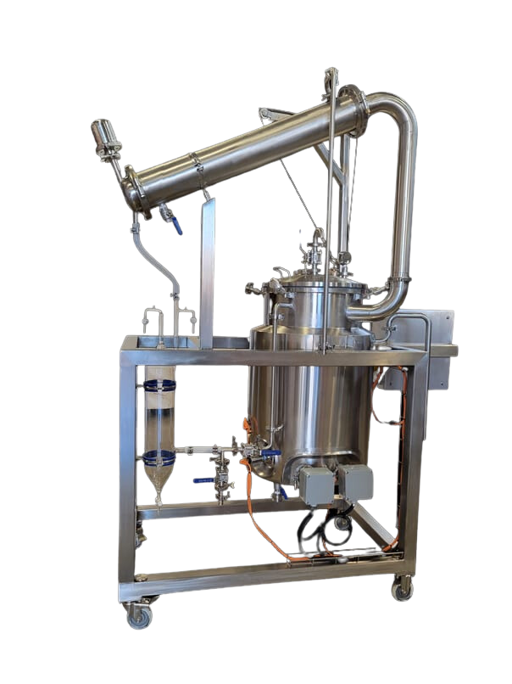
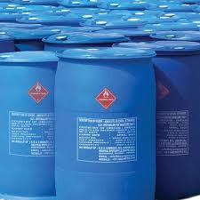
PACKAGING
DISTILLER
US$5,000-$5,500
US$0.25-$5

Slide 10




size of the
USD 135.07 billion in 2023
Total Available
Market (TAM) in World
market
USD$5 million
US$2.1 Million 26%per year
Total Market size in Nepal
Serviceable Obtainable
Market (SOM)

Slide 11

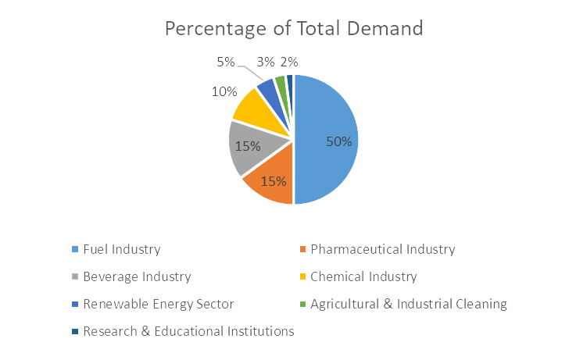
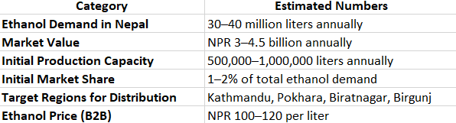
Market
Size in Nepal

Slide 12

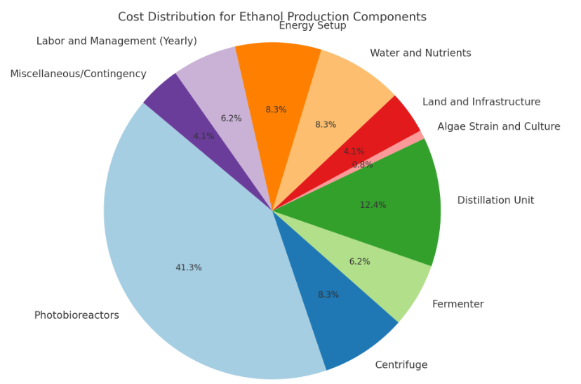
Initial
Investment
for $1m dollar revenue

Slide 13





Business Startegy
Core Activities
Revenue Streams
Target Customers
Cost Structure
Ethanol sales
Fuel industry
Setup
Grow algae
2. Renewable energy companies
2.Operational
2. Harvest and process algae
2. By-product utilization
3. Chemical, pharmaceutical, and beverage industries.
3.Logistics
3. Carbon credits
3. Refine ethanol

Slide 14


Value Proposition
Key Partnerships
Challenges
Scalability and Future Outlook
High production costs
Eco-friendly
Government
Tech investments to lower costs and boost efficiency
Scaling algae production
Diverse uses of ethanol
Fuel distributors
Increasing renewable energy demand
Reduces greenhouse gas emissions
Competition with other fuel sources.
Research institutions

Slide 15




THE
team
RUBY | CE0
AASHIKA | FINANCE MANAGER
Anonymous
SUSHIL | FOUNDER
SUSHANT | CFO

Slide 16
PHONE
+977 9863635324
contacts
ADDRESS
Changunarayan,Bhaktapur
We will be very pleased to work with you on future projects.
EMAIL
algenol@gmail.com

